Slide 1




Past Continuous
vs.
Past Simple
Review & Practice Questions

Slide 2

What do I need to remember?
Let's Review

Slide 3

Past Continuous
We use the past continuous to talk about events or situations that continued for a certain amount of time in the past or happened during a specific time.
We form the past continuous using the past of be and add -ing to the verb.
Example: It was raining while I was walking home last night.

Slide 4

Past Simple
We use the past simple to talk about events, habits, or situations that happened at a specific time in the past.
We form the past simple for regular verbs by adding the suffix (ed).
Example: It rained last night.

Slide 5
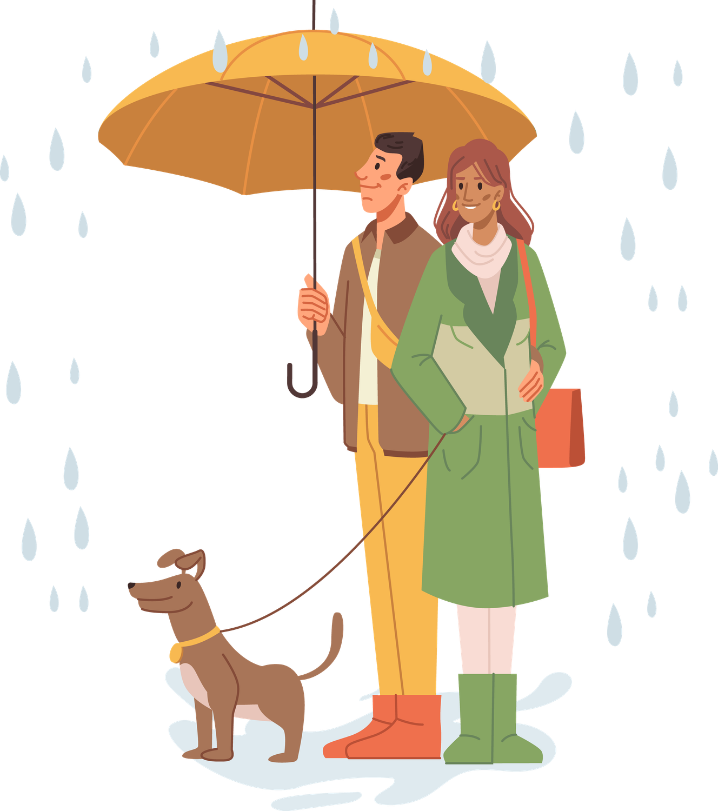
Past Continuous & Past Simple
In sentences, use when to combine the continuing action in the past with the completed one.
Example: We were walking our dog when it started to rain last night.

Slide 6

Let's Practice
I am Ready!

Slide 7
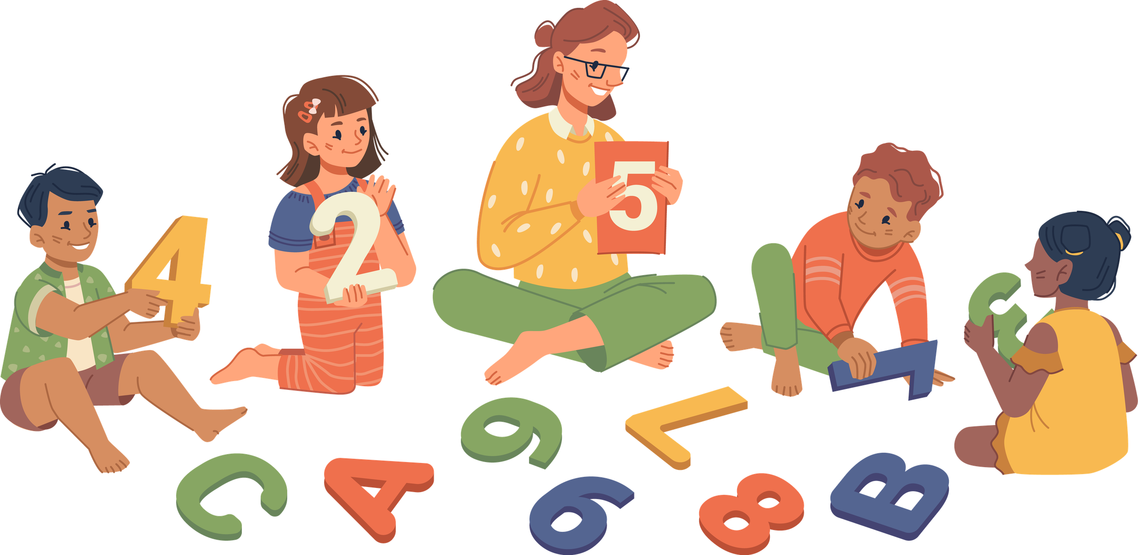
Practice Exercise
The children (play) ___________________________ while they _______________ (listen) to their teacher.

Slide 8
Practice Exercise
The children (play) ____were playing____ while they ___were listening___ (listen) to their teacher.

Slide 9
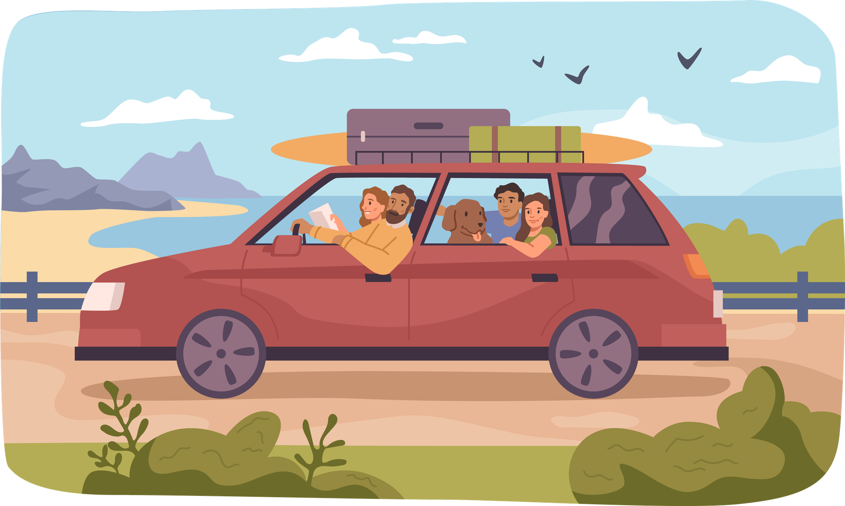
Practice Exercise
My family and I ___________________________ (go) on a road trip.

Slide 10
Practice Exercise
My family and I ________went_____ (go) on a road trip.

Slide 11

Practice Exercise
They __________ (study) English, when the principal ________ (come) into the classroom.

Slide 12
Practice Exercise
They ____were studying____ (study) English, when the principal _____came__(come) into the classroom.

